Slide 2
Integrating with OData Deep Dive
Understanding Data Entities and How to Make them Faster

Slide 3




About Me
Nathan Clouse
Microsoft Business Applications MVP
www.atomicax.com
Technical Architect
enVista Corp.
nclouse@envistacorp.com
@NathanClouseAX

Slide 4
Agenda
OData
Who, What, When, Where
What is OData good for?
What is OData not good for?
Other Considerations
Order Of Operations
Extensions
Authentication
Performance
Read
Pagination
Cross Company
Insert
Update
Delete
Actions
PostLoad

Slide 5
Sources
https://github.com/NathanClouseAX/AAXDataEntityPerfTest
http://www.atomicax.com/content/odata-experiment-deep-dive-odata-and-how-use-it
https://github.com/NathanClouseAX/AAXDataEntities
https://github.com/users/NathanClouseAX/projects/2

Slide 6

What is it?
OData
Open Protocol
Creation and consumption
Queryable and interoperable REST APIs
“The best way to REST”
.NET Connected Services

Slide 7

OData Data Entities
How are they made?
Set public to “yes”
That’s about it
Where is the code?
When compiling, code for a data entity gets created in package/bin/GeneratedXppSource
Ie; ApplicationSuite\bin\GeneratedXppSource
Autogenerated
Can review to see how entities work
Used for OData and DMF

Slide 8
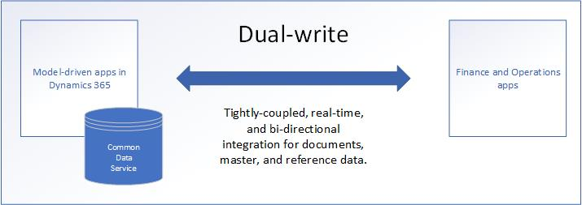
What About Dual Write?
Synchronous and bidirectional data flow between applications
Synchronization with online and offline/asynchronous modes.
Ability to sync initial data between the applications
Out-of-box setup experience for new customers
Dataverse

Slide 9

What is OData A Good Tool For?
CRUD operations on declared data entities
Includes customizations if new fields added to entities
Postings not generally supported such as posting a sales order invoice
Think “spreadsheet” or “List Management”
Used by the Excel Add-in

Slide 10

What is OData NOT A Good Tool For?
Data extraction in bulk
use the DMF with BYOD
export to data lake (when available)
Posting transactions
use a custom service
Managing data using the Power Platform
Use Dual Write

Slide 11

What is OData NOT A Good Tool For?
Extracting data on a schedule
Use recurring integration framework
Use batch data framework
React to something happening or changing
Use business events
Use Power Automate

Slide 12

Other Considerations
In Development / T1, all parts of the app are in the same place (SQL, IIS, MR, Batch, everything else)
IIS is configured differently between T1 and T2+
F&O
SQL

Slide 13
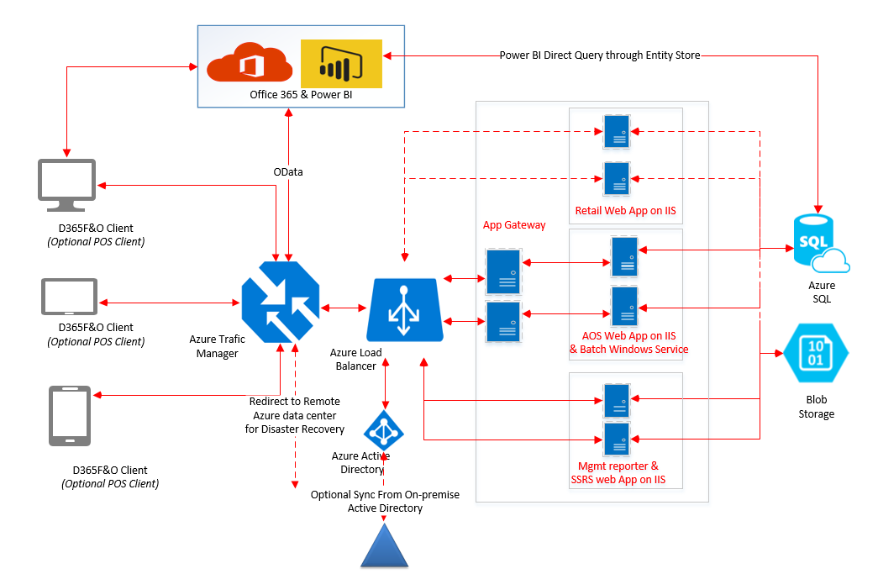
Other Considerations (cont.)
In UAT or greater / T2, all parts of the app could be or are known to be in different places, so network lag becomes a consideration
SQL
F&O

Slide 14
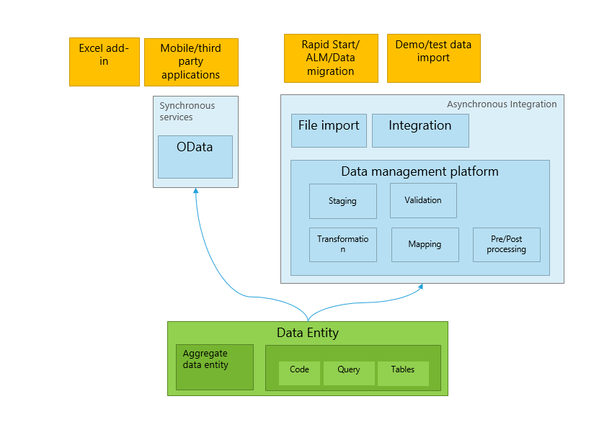
Data Entities Vs OData Data Entities
Little difference
Set “public” to yes
Very similar
OData enabled entities require a little more code
Optimized for OData usage
Enforce more business rules and logic
Tests should include DMF, x++ and C# (or similar) testing
Confirm all entry points give the same result

Slide 15
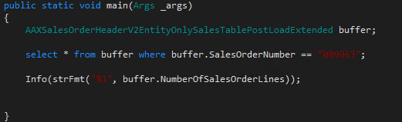

Slide 16
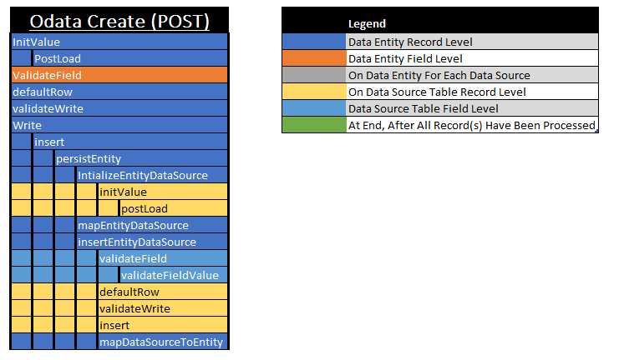
OData Create (POST)
Notes:
Originally created by Uwe Kreuger

Slide 17
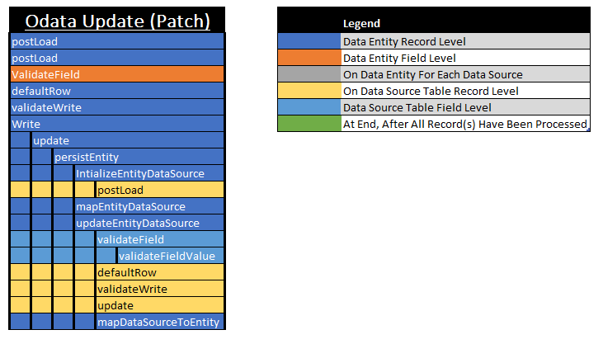
OData Update (PATCH)

Slide 18
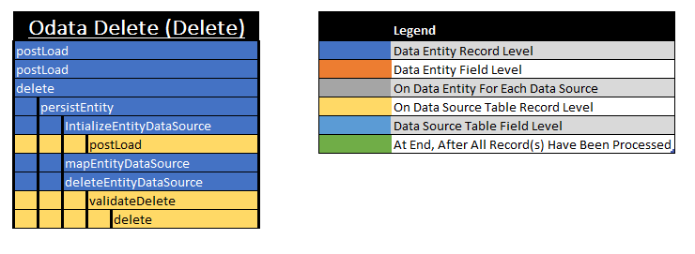
OData Delete (DELETE)

Slide 19
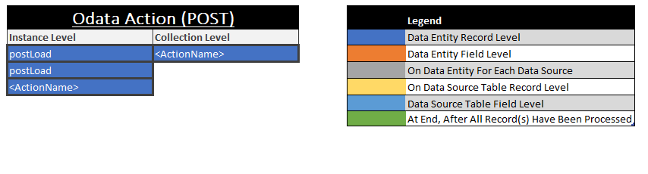
OData Action (POST)

Slide 20
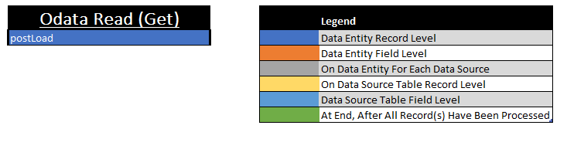
OData Read (GET)

Slide 21

Extensions
Extend Data Entity
Add data source
Add field
Add to staging table manually
Same extension rules as everything else
CoC
Event Handlers
Except OData Actions

Slide 22

Authentication
Controlled by an Azure App Registration
Tied to a user in F&O
User tied to a legal entity in F&O

Slide 23
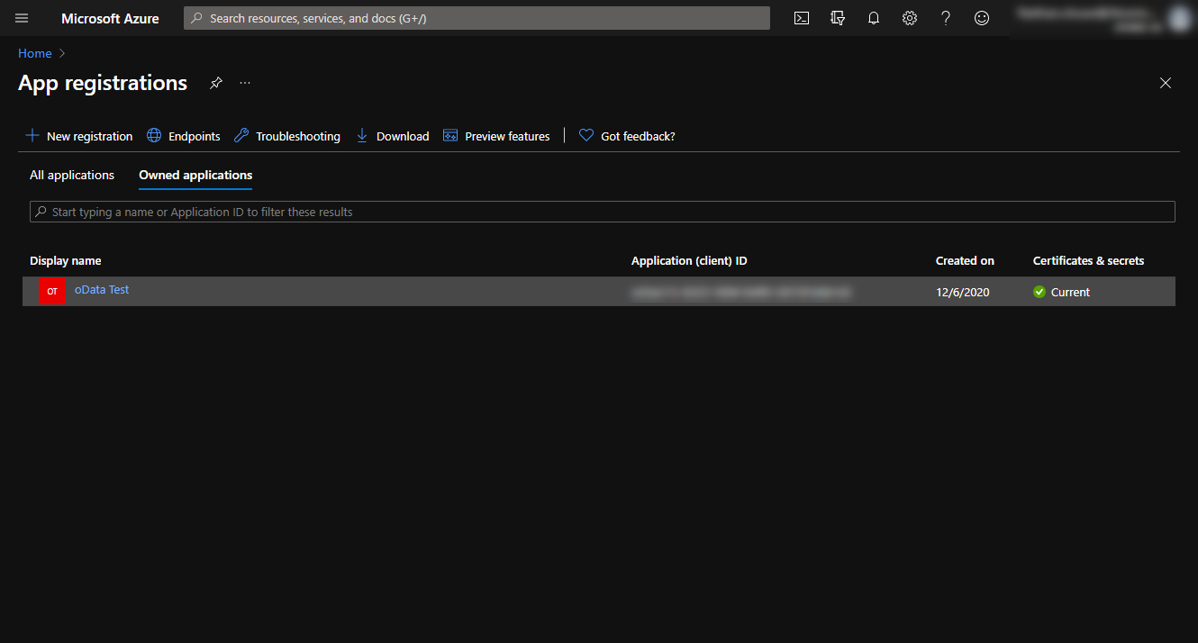

Slide 24
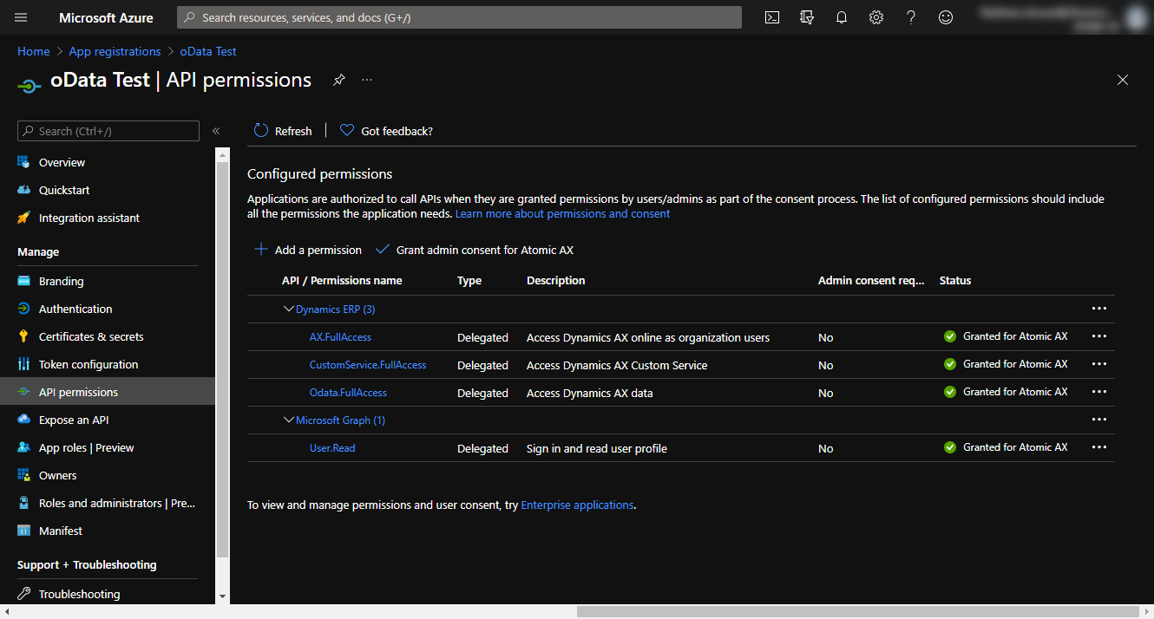

Slide 25
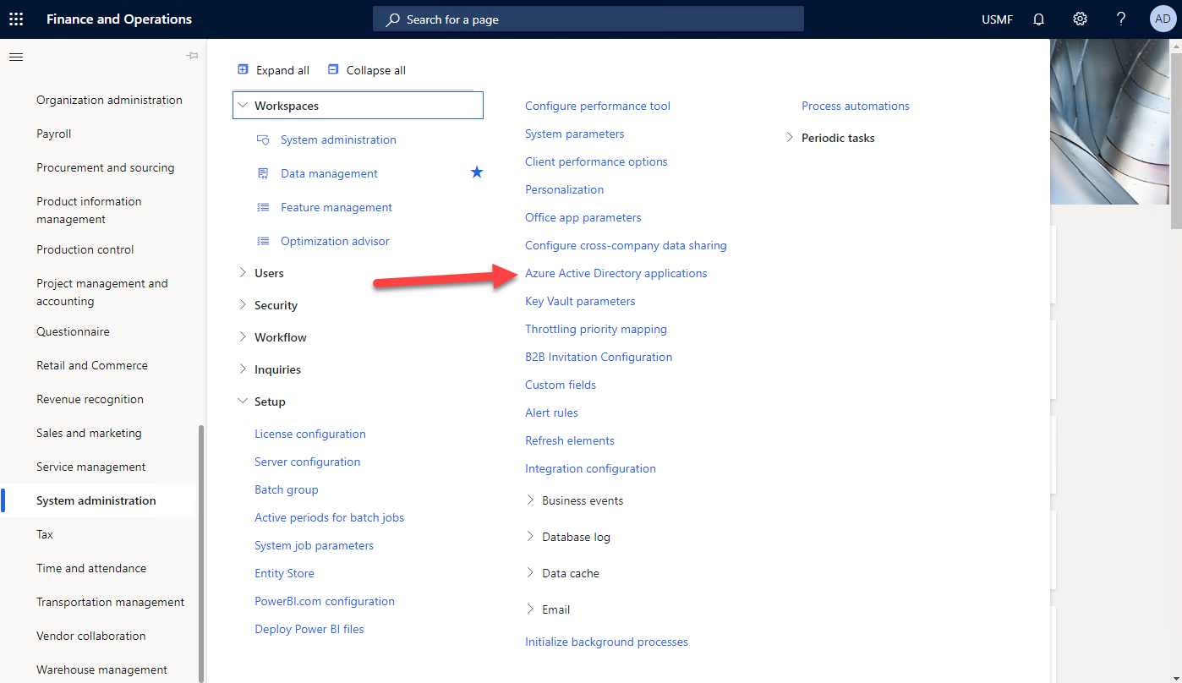

Slide 26

Read Performance
Biggest, most visible area for performance
(probably) the bulk of the workload for a given integration
Have to scope before you can update or delete
Customer Portal: get list of orders, select one from a list, get the details for that order, review extended details (pick list, pack slip, invoice, etc)
Customer Workspace: User get’s a list of order, selects one from that list, gets details, makes changes, sends update

Slide 27

Read Performance – Data Entity Complexity
Fewer Columns = “faster”
Fewer table / joins = “faster”
ReadOnly attribute is for functionality, not performance
“faster” for 1 row means more faster for 10+ rows
Row vs Set behaves differently

Slide 28
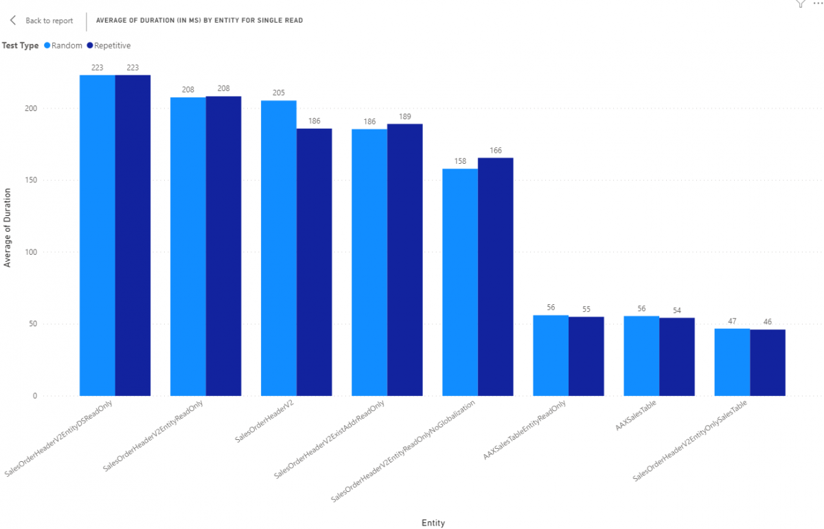

Slide 29

Read Performance – Data Entity Complexity
No sub-selects is ideal
Data entity gets boiled down to be a SQL view
Views can contain sub-selects to other data sources
Can ( and will ) kill performance

Slide 30
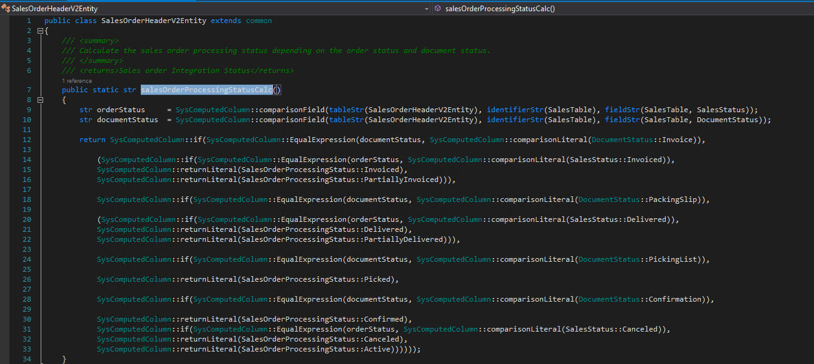

Slide 31
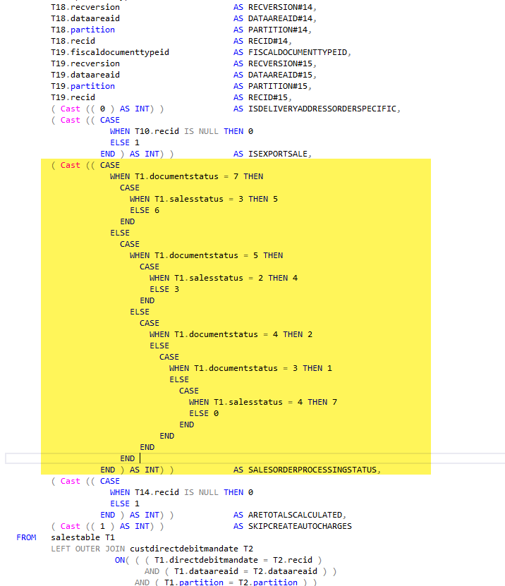

Slide 32
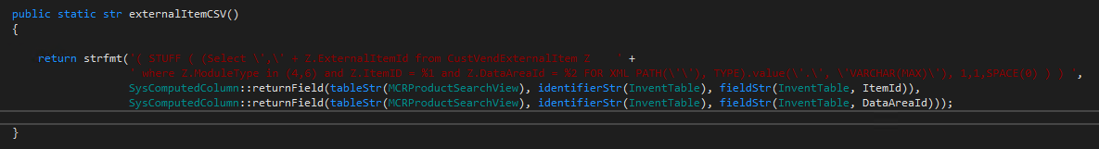
Notes:
Correlated subqueries should be used sparingly (i.e. when an inner condition refers to an outer clause).
Source: https://www.linkedin.com/pulse/d365fo-join-table-csv-column-viewdata-entity-michael-schiermeyer/

Slide 33

Read Performance – Consumer Tricks
Use SELECT() to specify list of fields to return
Using a SELECT() will provide some performance improvements when fetching more than 1 record
Using a SELECT() will provide some performance degradation when fetching just 1 record

Slide 34
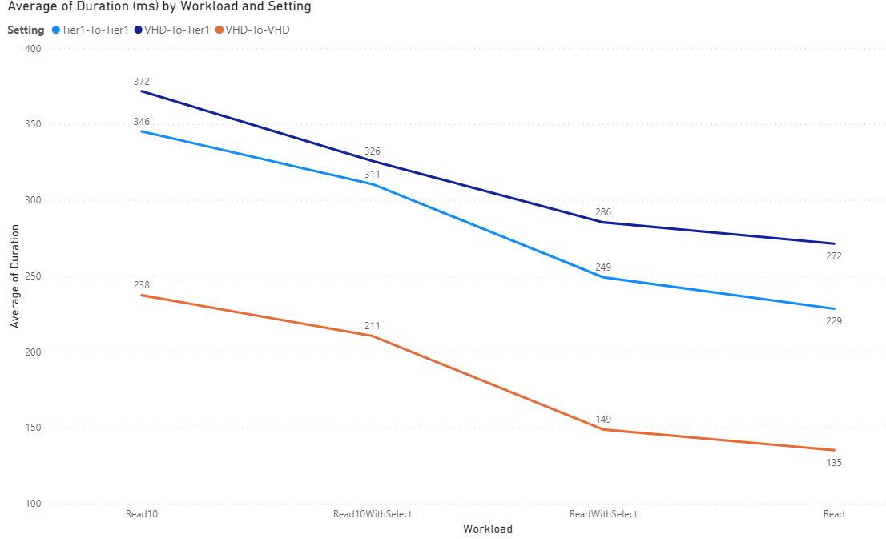
1
2
3
4
Notes:
Using SalesOrderHeaderV2 OOTB entity
1 reading 10 Sales Orders
2 reading 10 sales orders with a SELECT() on 5 fields – only getting 5 fields
3 Reading 1 record with SELECT() on 5 fields,
4 reading 1 record

Slide 35

Read Performance – Consumer Tricks, Part 2
Filter based on underlying data sources indexes
If a specific index isn't known, specify everything you can and let SQL pick an index for you
The better the index selection for a query, the faster the query is as well as being more reliable and predictable from a performance perspective

Slide 36
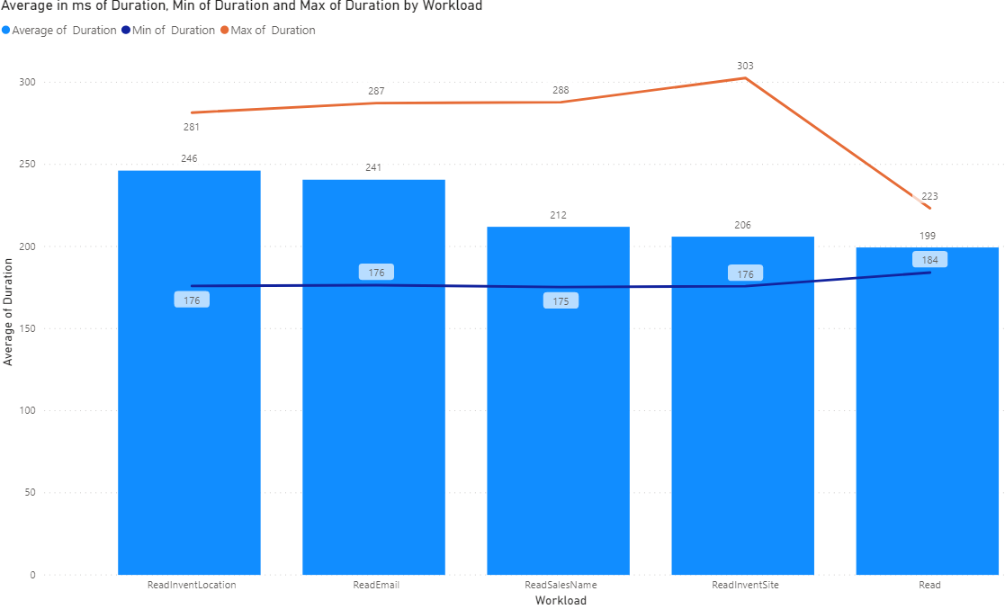
Notes:
Fetching 1 record by specific indexes on SalesOrderHeaderV2
Callout that sales order header v2 has range on SalesType = SalesOrder
No index on inventLocationId, email, salesname, or inventsite
Note that the best performing is just SalesId

Slide 37
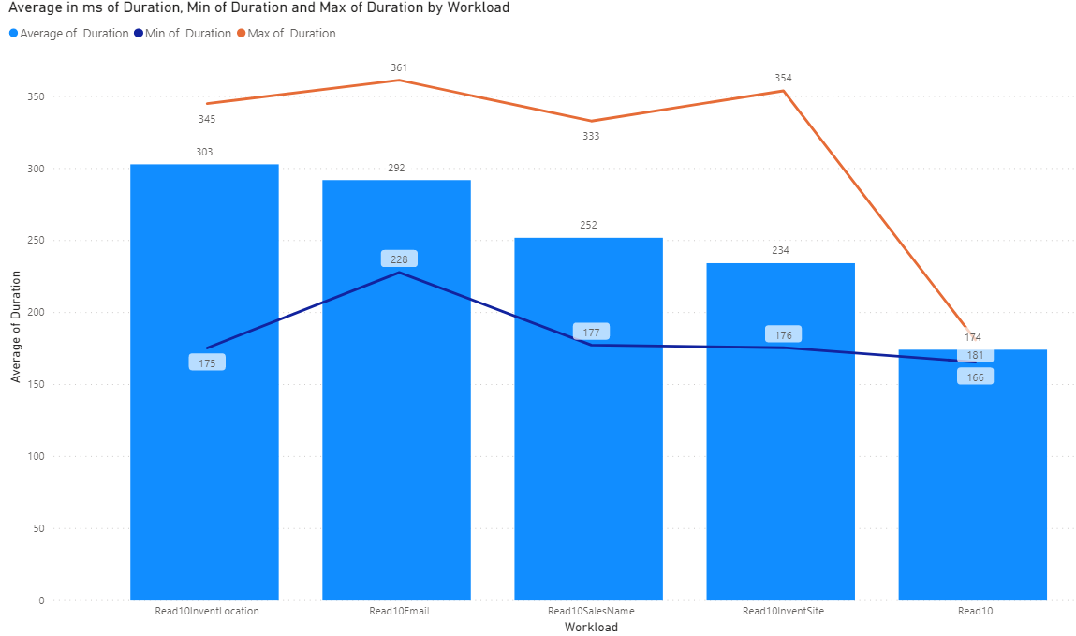
Notes:
Fetching 10 record by specific indexes on SalesOrderHeaderV2
Note that the best performing is just SalesId

Slide 38
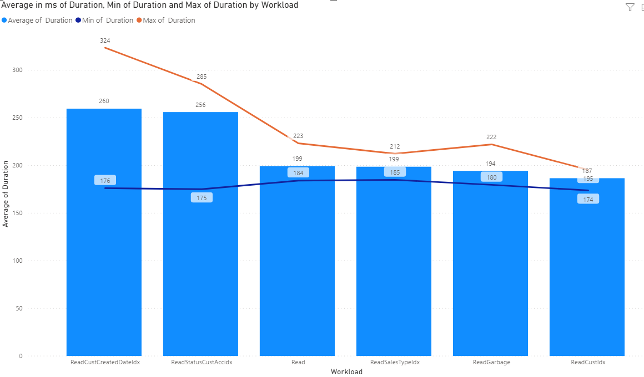
Notes:
ReadCustCreatedDateIdx - We fetched records specific on fields DataAreaId, CustAccount and CreatedDateTime 100 times. This ended up being our worst performing index despiate the DateTime being part of the index. This also had the most variability so I suggest not using a DateTime based index for lookups. This index is not unique.
ReadStatusCustAccIdx - We fetched records on fields DataAreaId, SalesStatus and CustAccount 100 times. This was marginally better than the CustCreditDateIdx. This index is not unique.
Read - We fetched records on DataAreaId and SalesId. This is a standard random read on a Sales Order header. This index is unique so that is why it is so much faster than the CustCreatedDateIdx and StatusCustAccIdx.
ReadSalesTypeIdx - We fetched records on DataAreaId, SalesType and SalesId. Similar to the "read" test, we're looking up against a unique index but this index, SalesTypeIdx, is a subset of SalesId Index so its slightly more specific so it was marginally faster in our tests.
ReadGarbage - This was the wildcard in the test as we aren't hitting any specific index by design. We did 100 lookups based on all columns in all indexes included in tests so far to see if SQL would pick and use the best index based on what we were looking up data on. The good news is that it did a fairly decent job of picking an index and returning the data in a fairly short amount of time. This approach, where we are specifying a WHERE with as much info as we have, seems to work just fine if we don't know of or have a specific index we want to lookup against.
ReadCustIdx - We fetched records on DataAreaId, CustAccount, SalesId and PurchOrderFormNum. This was our best performing lookup by index and reviewing the features of the index, it makes sense. This index, CustIdx, has CustAccount, SalesId and PurchOrderFormNum all together as a unique index. In terms of how SQL is looking at data it will do a "soft filter" based on CustAccount first then lookup SalesId then PurchOrderFormNum from that initial "soft filtered" list so it just ends up being faster because it uses parts of the WHERE to get rid of just to scan prior to doing any additional scans.

Slide 39

Read Performance – Consumer Tricks Part 3
Limit use of ORDER BY statements
ORDER BY on a specific index
Calculated fields / Sub-selects are marginally more performant than "normal" fields not in an index
May be based on limited dataset from Contoso
Test with your data

Slide 40
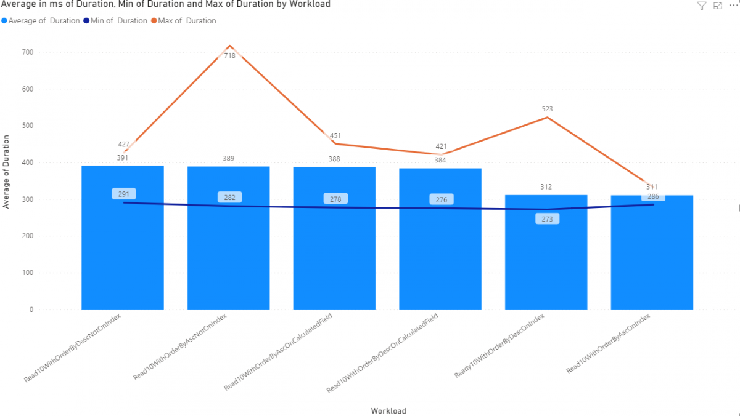
Notes:
Dev VHD machine

Slide 41
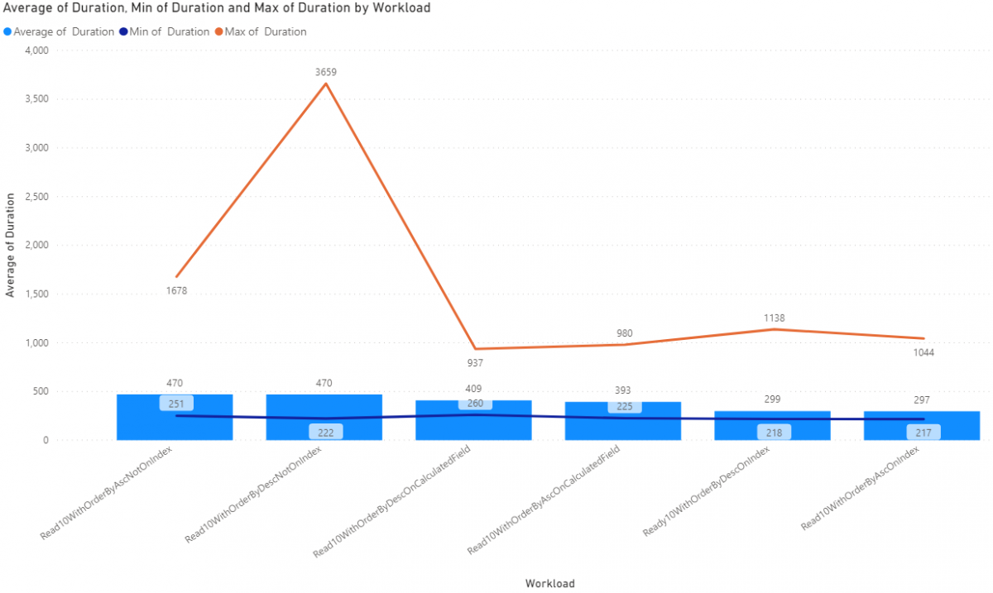
Notes:
UAT

Slide 42

Read Performance – Multi-threading
More work means longer working times
Largely a CPU constrained throughput problem
More CPU means more speed
Request processing times scale linearly with thread count
Development, UAT and PROD could and/or will act differently
Don't do this

Slide 43
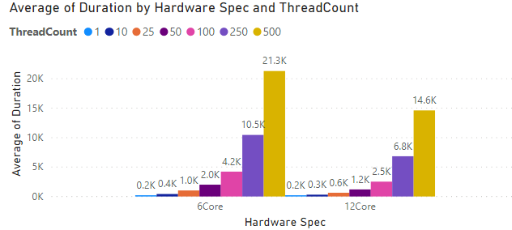

Slide 44
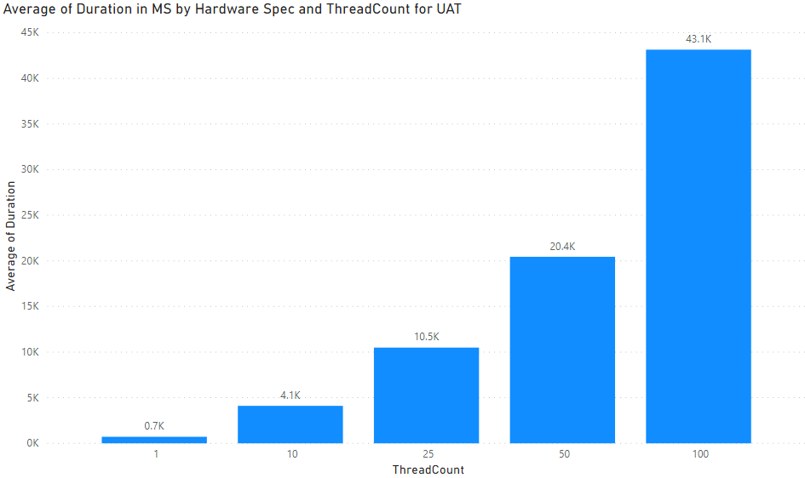

Slide 45

Read performance – EXPAND()
EXPAND() let’s you bring in data from a declared relationship
Slower on T1 compared to doing 2 requests
Faster T2+ compared to doing 2 requests

Slide 46
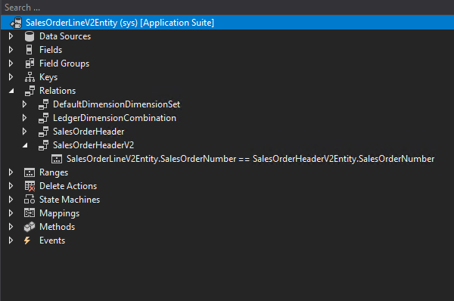

Slide 47
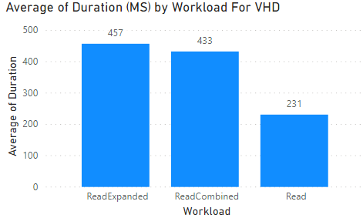
Development

Slide 48
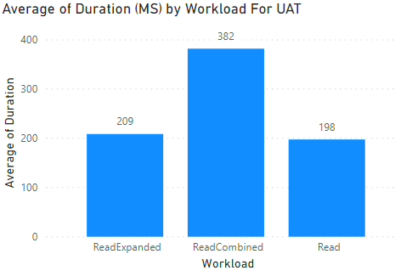
UAT / T2+

Slide 49

Pagination
2 Methods
Skip and Take
Take x while skipping y
Take 10000, skip (offset)
Continuation
Each page has a link to the next
This follows that link

Slide 50
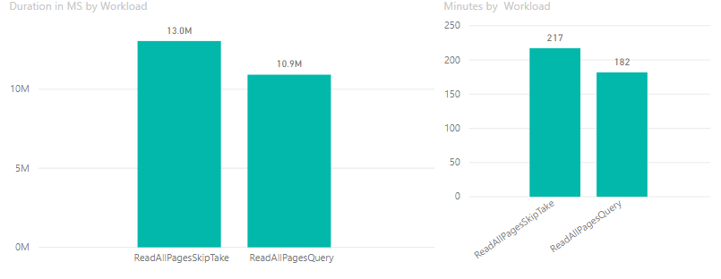
Read performance – Pagination

Slide 51
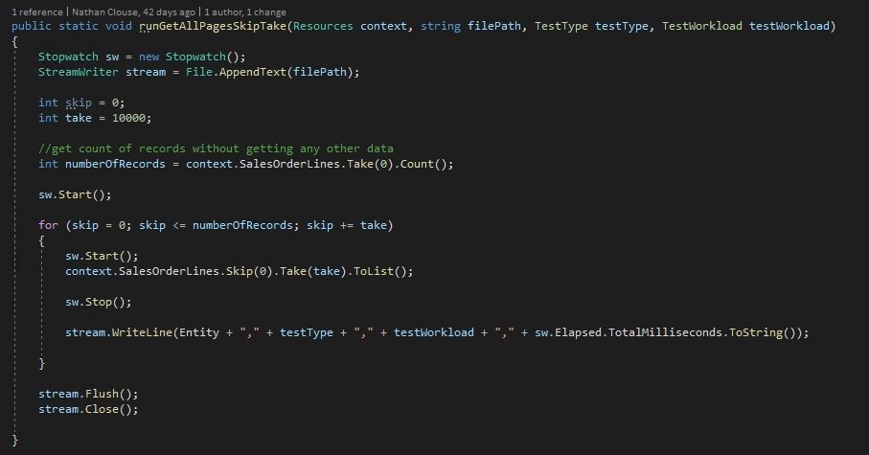
Notes:
Skip and take

Slide 52
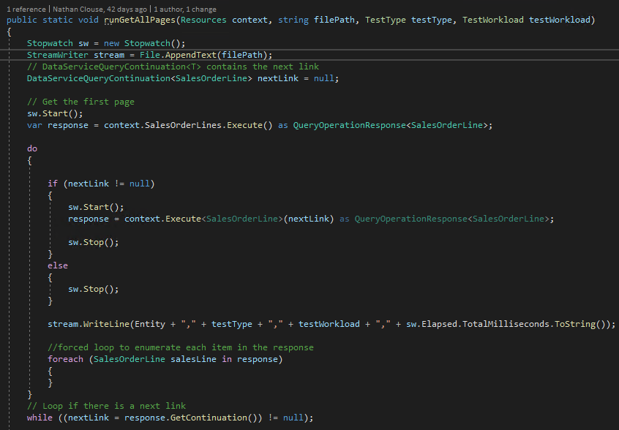
Notes:
pagination

Slide 53
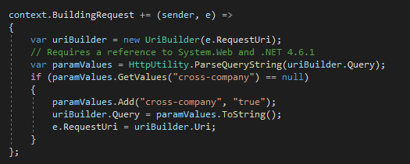
Cross Company
Get data from ALL legal entities
Authentication tied to user
User tied to company

Slide 54

Read Performance - Simplicity
May have to copy/paste OOTB entities and remove features for performance
“Chop Out” what you don’t need
Build your own based on needs
Must reconcile changes with each release
Complete control

Slide 55
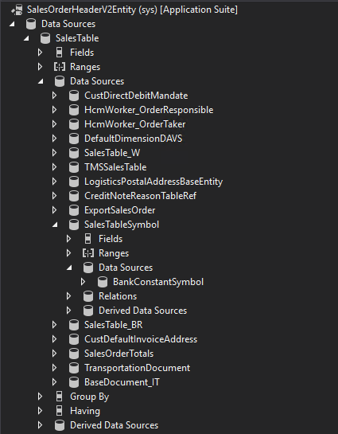
Notes:
green arrows are localizations
Light Blue are entities or views that cause slowness
Dark blue is related to specific functionality that may not be used

Slide 56

Insert Performance – “Compound” Entities
Have lots of data sources
Lots of code
Performance scales to amount of data being persisted.
A few fields only is fast
Adding more fields increases time to persist
Saving data in many fields also increases time to persist

Slide 57
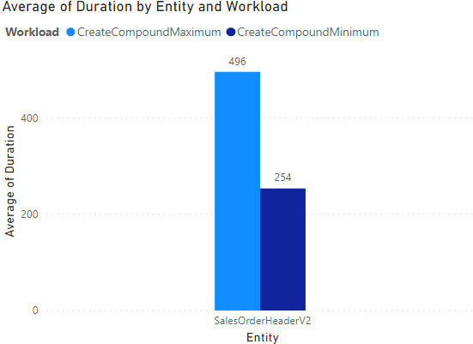
Development

Slide 58
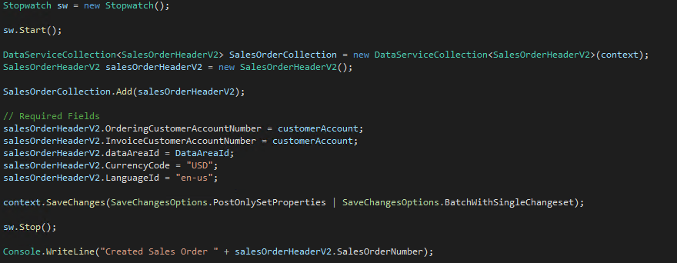
“Minimum”

Slide 59
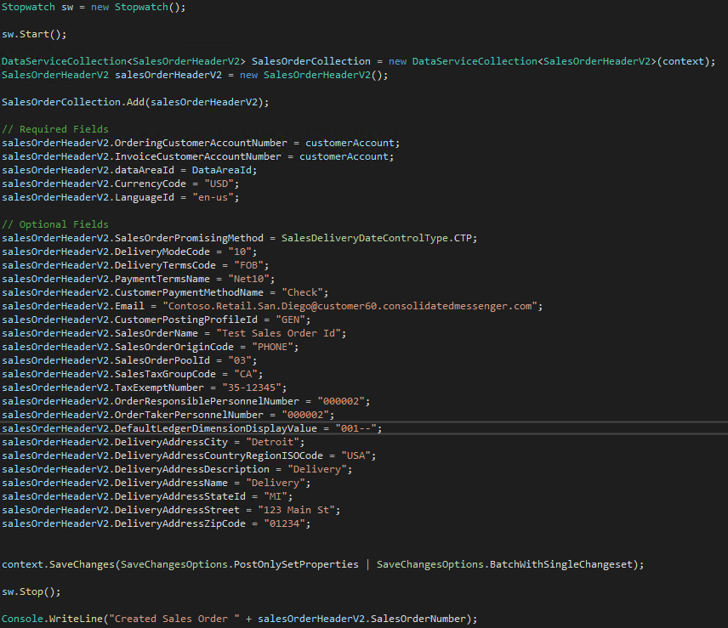
“Maximum”

Slide 60
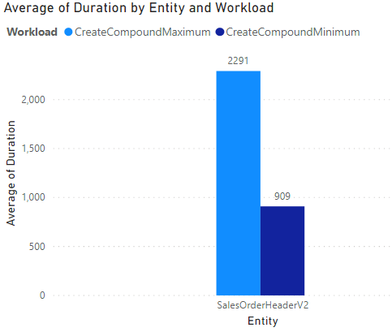
UAT / T2

Slide 61

Insert Performance – “Simple” Entities
Simple entities
Have only 1 or 2 tables (minimum of what is required for the specific requirement)
Can handle very little code, only what is required to fill the need
Again, Performance scales to amount of data being persisted.

Slide 62
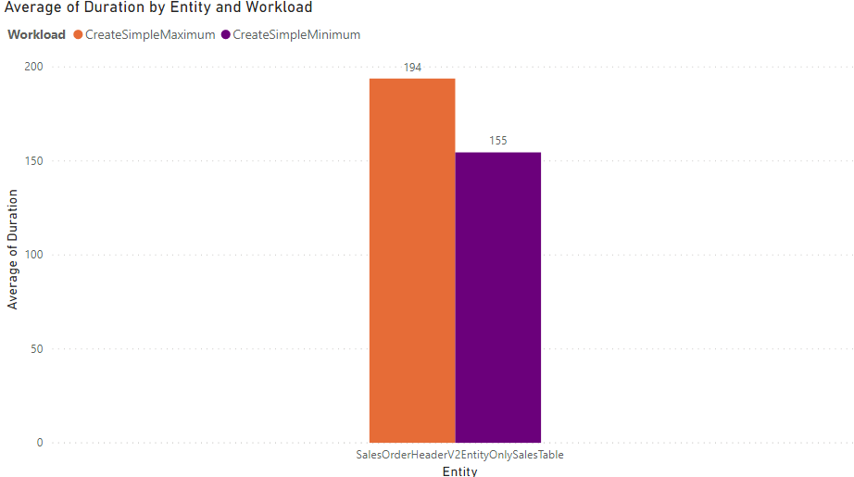

Slide 63
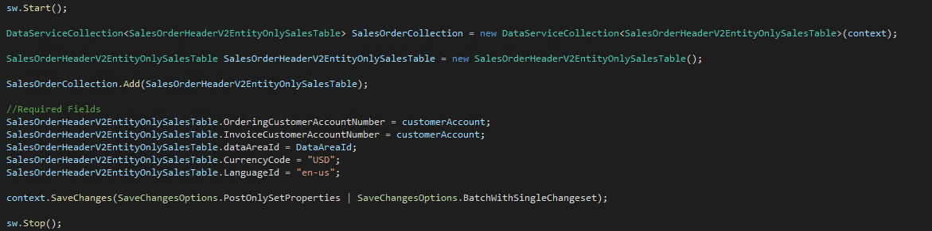
“Minimum” insert with simple entity

Slide 64
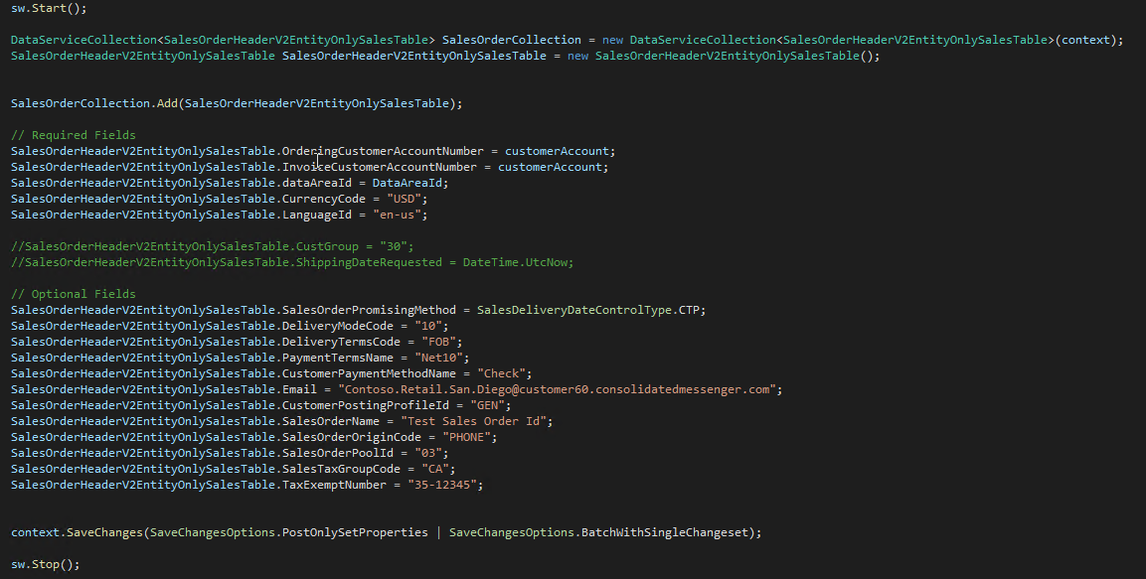
“Maximum” insert with simple entity

Slide 65
Comparison

Slide 66

Update Performance
Same as insert performance
Updating fewer fields is faster than updating lots of fields
Business logic in classes/tables will always execute
“Simplicity” doesn’t quite scale as well

Slide 67
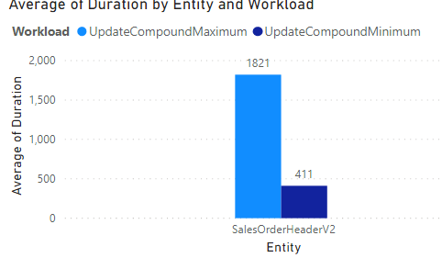
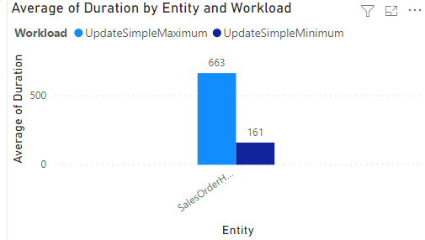
Compound
Simple

Slide 68

Delete Performance
Similar to insert performance
Unique Case
Only need to know the key to delete it
Scope on primary key
Then delete
Is it faster?
Can I Switch entities?
“simple” is faster than compound
“single” is the fastest

Slide 69
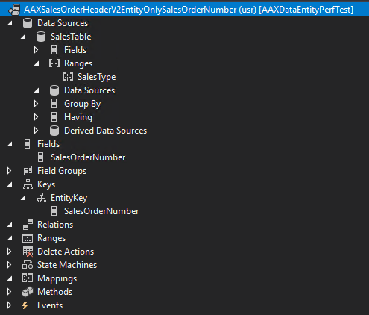

Slide 70
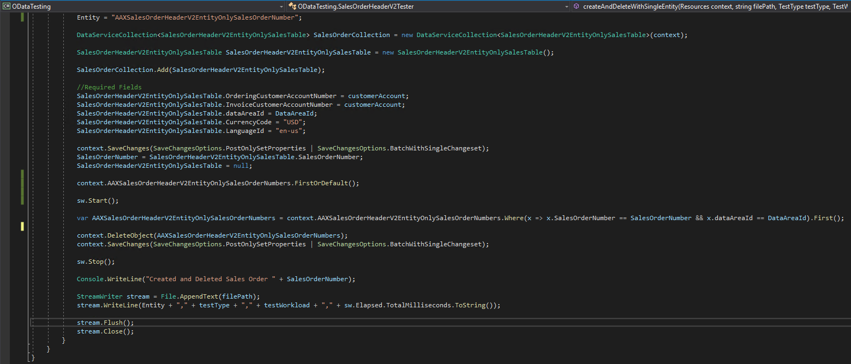

Slide 71
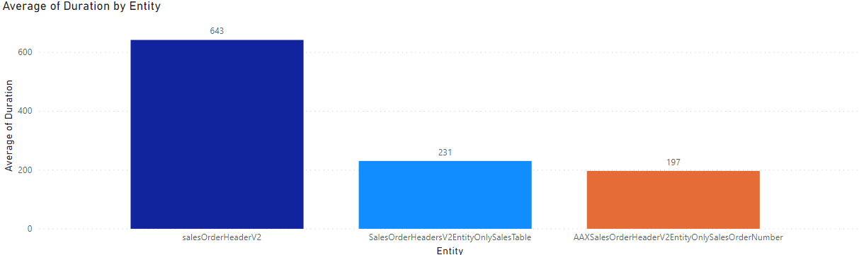
Delete Performance By Entity Type

Slide 72

Actions
Let's you add behaviors onto an entity
Customers Last Order Date
CustomerV3.LastOrderDate();
Lookup against SO’s for the last one from that customer
Can be on entities or collections
Can also create/update data

Slide 73

What about PostLoad()?
Kernel method executed when a record is loaded
Can be used on tables, views, data entities and maps
Used on Data Entities to add values on unmapped fields
Whatever you want to do in X++

Slide 74

What about PostLoad()?
Insert – 2 times
Update – 3 times
Delete – 3 times
Select – 1 time
Action – 2 times

Slide 75
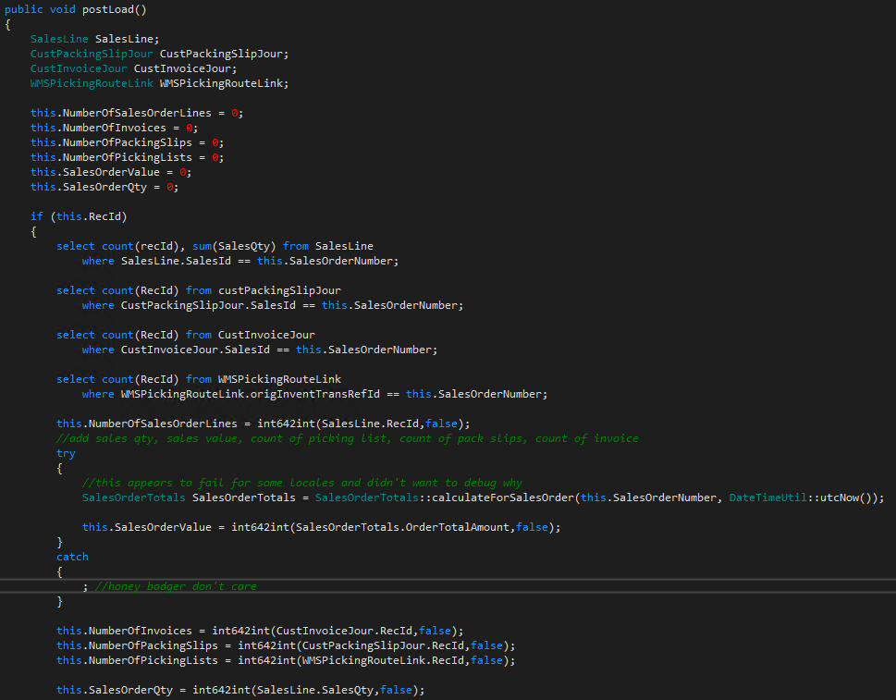

Slide 76
Recap
Read Workloads
Fewer columns is better
Fewer joins is better
ReadOnly attribute is for functionality
Avoid sub-selects
Use SELECT() to reduce network lag for sets
Filter based on indexes
Limit use of ORDERBY(); sort after you get data
Use ORDERBY() on an index when used
Use EXPAND() when it makes sense
Don’t Multi-thread OData calls
Insert and Update
Fewer columns is better
Fewer joins is better
Fewer fields specified in operation is better
Create “Simple” entities, if applicable
Delete
Use “Single” entity for best performance
Build
Measure
Learn

Slide 77
Nathan Clouse
Microsoft Business Applications MVP
Technical Architect enVista Corp.
Microsoft Business Applications MVP nclouse@envistacorp.com www.atomicax.com
@NathanClouseAX

